Slide 1
Welcome back to Junior Jellies Summer Python

Slide 2
We are going to learn more Python.
Log back into repl.it

Slide 3
You will get a url sent to you by one of the advisors.
Click on it

Slide 4
We are going to recap some Python things from last lesson.

Slide 5
Remember how we make the user type in a value?

Slide 6
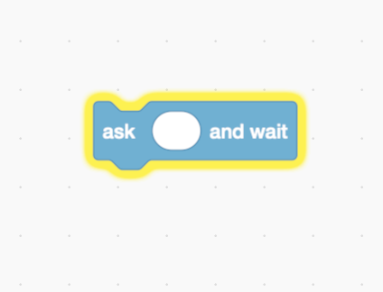
input()

Slide 7
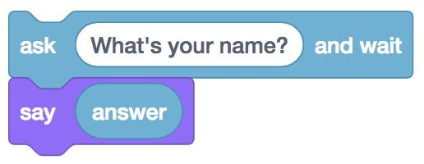
answer = input(“What’s your name?”)
print(answer)

Slide 8
How to get Python to say your name
Make sure to click “Run” first
Then enter your name and enter

Slide 9
Write the code to get Python to ask for your name and then say your name
Then write the code to get Python to ask and then say your age

Slide 10
How do we get Python to say hello to you?
Example: “Hello, Johnny”

Slide 11
We need to combine a string with a variable.
This is very easy to do
Just use a + sign to combine two Strings

Slide 12
“Hello, “ + “Elliot” “Hello Elliot”
name = “Elliot”
print(“Hello, “ + name) “Hello Elliot”

Slide 13
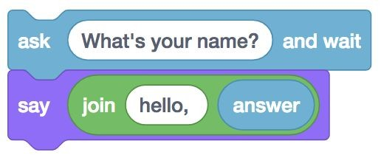
How do we get Python to do this?

Slide 14
name = input(“What’s your name?”)
print(“Hello, ” + name)

Slide 15
Now get Python to ask for your name and then say
“Hello, (your name)”

Slide 16
Now get Python to ask how you are feeling today and then say
“You are feeling very (input) today.”

Slide 17
Are you ready to create a MadLib?

Slide 18
How to create a Mad Lib?
1. Ask the user for a part of speech
(noun, adjective, verb, etc.)
2. Save every user’s response to a different variable
3. Print out a phrase and insert the variables to create a Mad Lib

Slide 19
Your instructor will now walk you through how to make a Mad Lib through Repl.it
Watch and learn

Slide 21
Now, create your own MadLibs. If you need help, just raise your hand

Slide 22
When you’re done with one, make another funny Mad Libs. Try to make it longer if you can.

Slide 23
Remember Strings and Integers?
There is also another data type:
Booleans

Slide 24
What are Booleans?
Booleans can be two different values:
True or False

Slide 25
How do we make a boolean?
Easy
variable1 = True
variable2 = False

Slide 26
There are different ways to write booleans

Slide 27
Simple Question:
Is it true that four is equal to four?
Is it true that five is equal to four?

Slide 28
Simple Answer:
Four is equal to four
Therefore, “four equals four” is a True statement

Slide 29
Simple Answer:
Five is not equal to four
Therefore, “five equals four” is a False statement

Slide 30
Coding Lesson:
In programming, we usually use the “=” to assign the variable on the left, to the value on the right
counter = 0
counter = 1
print(counter)
**Output: 1**

Slide 31
If we use the “=” sign, the computer is going to think that you are changing the value of a variable
That’s why
we use the “==” sign

Slide 32
Examples:
print(4 == 4) *Output: True*
print(5 == 4) *Output: False*
print(“Hello” == “Hello”)
*Output: True*

Slide 33
More Examples:
print(“Bye” == “Hello”) *Output: False*
print(“JJ” == “JJ”) *Output: True*
print(10010 == 10010) *Output: True*

Slide 34
Print three Boolean statements
Make sure Python prints either True or False

Slide 35
How do we want to say that something is NOT EQUAL to something?

Slide 36
We use the != sign

Slide 37
What would the output of all of these be?
print(5 != 4)
print(6 != 5)
print(“bye” != “hello”)

Slide 38
print(5 != 4)
print(6 != 5)
print(“bye” != “hello”)
They are all True statements
It is true that 5 is not equal to 4
It is true that 6 is not equal to 5
It is true that “bye” is not equal to “hello”

Slide 39
What would the output of all of these be?
print(5 != 5)
print(6 != 6)
print(“bye” != “bye”)

Slide 40
print(5 != 5)
print(6 != 6)
print(“bye” != “bye”)
They are all False statements
It is not true that 5 is not equal to 5
It is not true that 6 is not equal to 6
It is not true that “bye” is not equal to “bye”

Slide 41
Print another three Boolean statements using the != sign
Make sure Python prints either True or False

Slide 42
Do you remember
if statements from the first lesson?

Slide 43
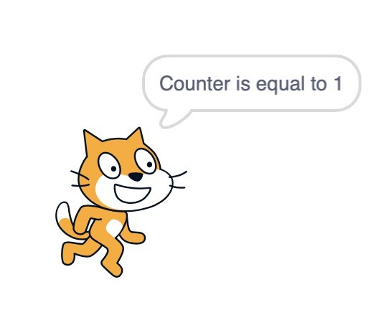
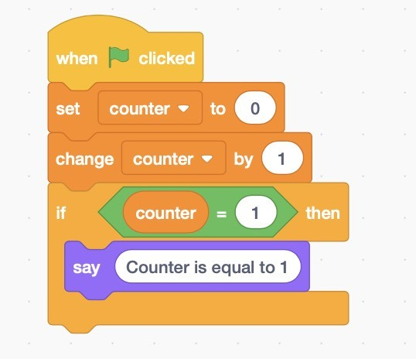
Do you remember this?
This is an if statement

Slide 44
Do you remember this?
This is an if statement

Slide 45
Coding Lesson:
In programming, if statements must have a boolean statement in it.
Confused? Just watch

Slide 46
What do you notice about this?
if 4 == 4:
print(“Four is equal to four”)
*Output: 4*

Slide 47
What do you notice about this?
if 4 == 4:
print(“Four is equal to four”)
*Output: Four is equal to four*
Boolean statement

Slide 48
What do you notice about this?
if 4 == 4:
print(“Four is equal to four”)
*Output: Four is equal to four*
Is four equal to four?

Slide 49
What do you notice about this?
if 4 == 4:
print(“Four is equal to four”)
*Output: Four is equal to four*
Four is equal to four

Slide 50
Other really important things to note:
if 5 != 4:
print(“5 is not equal to 4”)
Every if statement MUST END WITH A COLON

Slide 51
Other really important things to note:
if 5 != 4:
print(“5 is not equal to 4”)
Every line that will run under the if statement MUST BE INDENTED

Slide 52
Demo Time:
Your advisor will write an if statement
You will then be asked to write an if statement
Make sure you follow all of the rules

Slide 53
We can also use != for if statements
if 5 != 4:
print(“5 is not equal to 4”)
**Output: 5 is not equal to 4**

Slide 54
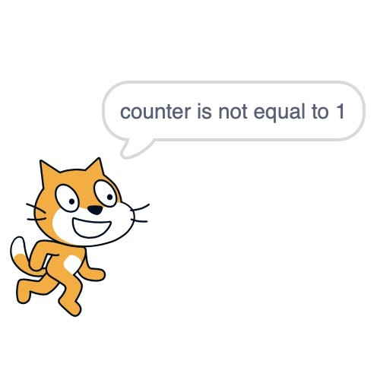
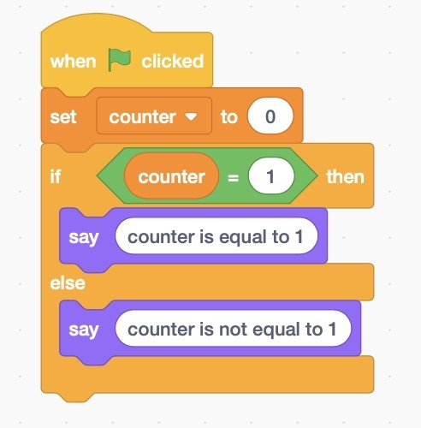
Can we do an if/else statement?

Slide 55
Can we do an if/else statement?

Slide 56
Very easy
if 5 == 4:
print(“Five is equal to four”)
else:
print(“Five is not equal to four”)
*Output: Five is not equal to four*

Slide 57
Notice the same patterns
if 5 == 4:
print(“Five is equal to four”)
else:
print(“Four is not equal to four”)
The colon is still there

Slide 58
Other really important things to note:
if 5 == 4:
print(“5 is equal to 4”)
else:
print(“5 is not equal to 4”)
Every line that will run under the else statement MUST BE INDENTED

Slide 59
Demo Time:
Your advisor will write an if/else statement
You will then be asked to write an
if/else statement
Make sure you follow all of the rules

Slide 60
Demo Time:
Your advisor will write an if/else statement
You will then be asked to write an
if/else statement
Make sure you follow all of the rules

Slide 61
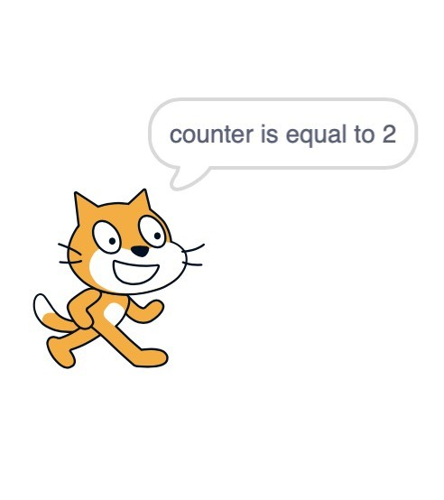
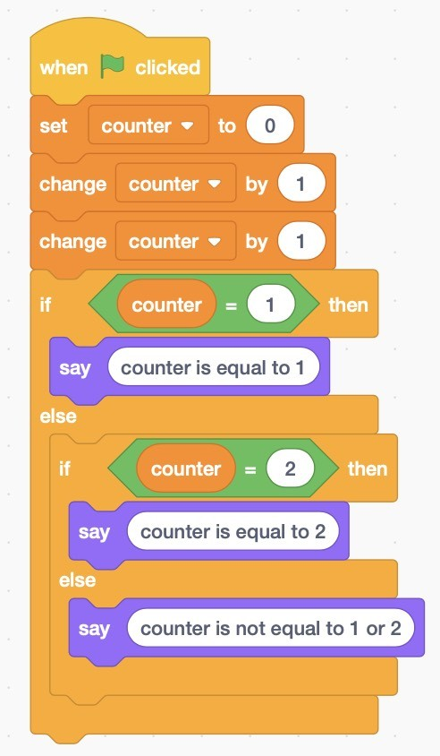
Can we do an else/if statement?

Slide 62
if 5 == 4:
print(“Five is equal to four”)
elif 5 == 5:
print(“Five is equal to five”)
else:
print(“Five is not equal to four or five”)
*Output: Five is equal to five*
Notice the same patterns
(colon and indentation)

Slide 63
Demo Time:
Your advisor will write an
if/elif/else statement
You will then be asked to write an
if/elif/else statement
Make sure you follow all of the rules

Slide 64
How can we use variables with if statements?

Slide 65
name = “Alex”
if name == “Bob”:
print(“Hi, Bob!”)
elif name == “Alex”:
print(“Hi, Alex!”)
else:
print(“Hi, person!”)
variable

Slide 66
age = 10
if name == 5:
print(“You are 5 years old”)
elif name == 15:
print(“You are 15 years old”)
else:
print(“You are not 5 or 15 years old”)
variable

Slide 67
Write multiple statements using a variable

Slide 68
Let’s make a True/False Game

Slide 69
Outline of the game:
Present a question
Have the person type “t” if they think it is true and “f” if they think it is false
If they guessed correct, add one point for the person and move on to the next question
When every question is asked, show them their final score and the percentage of correct answers

Slide 70
First, we are going to track the user’s score by creating a variable
points = 0

Slide 71
We are going to ask the question and
get the user’s response using
input()
We will then check if the user’s response is correct by using an if statement

Slide 72
If the user typed in the correct response, then the computer should add one point to the variable score.
At the end of the game, we will print the total points.

Slide 73
Little peek
points = 0
answer = input(“True or false: Johnny loves Oreos”)
if answer == “true”:
points += 1
answer = input(“True or false: Johnny likes bugs”)
if answer == “false”:
points += 1
print(“Game over. You got “ + points + “ points.”)

Slide 74
Your instructor will give you a demonstration.
You will then make your own true/false game
Good luck!

Slide 75
Thank you for joining
Reminder:
NO MEETING NEXT WEEK
(7/27 + 7/29)
Sneak peek for next lesson:
trivia game + rock paper scissor

